Slide 1
Candidate Briefing
Notes:
10.30am

Slide 2
Congratulations
Notes:
10.30am

Slide 3
Introduction & Being a Trustee- Kirsty Morrison, CEO
The roles, rules and regulations - Dows
Support from Staff - Ellie and Maisie
How to campaign - Dows
Photos
30 Sec Video
Notes:
10.30am

Slide 4
Hello
Kirsty Morrison, CEO
Notes:
10.30am

Slide 5
Trustee Responsibility
Charity Trustee: what’s involved (CC3a)
Charity Commission
Notes:
10.30am

Slide 6
Trustee Responsibility
Overall control of charity and are responsible for making sure it’s doing what it was set up to do.
You will make decisions that impact on people’s lives.
You will make a difference to the community.

Slide 7


Slide 8
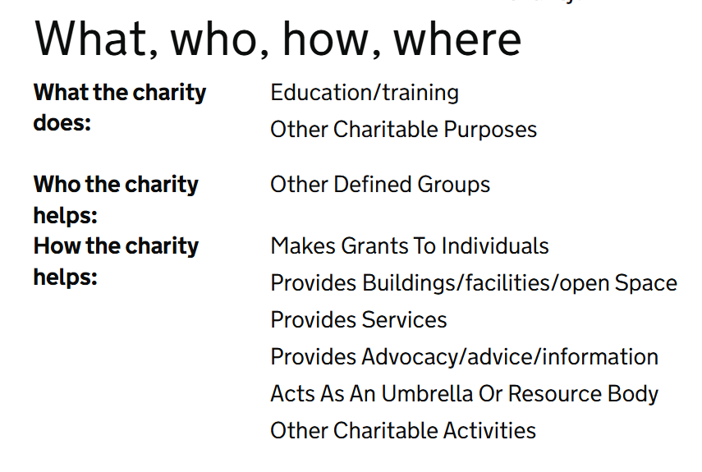
Trustee Responsibility – Main duties
Ensure your charity is carrying out its purposes for the public benefit.
Understand as set out in governing docs
Plan what your charity will do
Explain how activities further purpose
Understand how public benefit from purpose
Notes:
Eligibility checks done!
Constitution and byelaws underpinning this
Strategic direction
Can tell others these topline activities
Know how this benefits our students

Slide 9
TUSU –
1. Ensure your charity is carrying out its purposes for the public benefit.
Constitutional / Charity Objectives:
The Union’s objects are the advancement of education of Students at Teesside University for the public benefit by:
Promoting the interests and welfare of Students at Teesside University during their course of study and representing, supporting and advising Students;
Being the recognised representative channel between Students and Teesside University and any other external bodies; and
Providing social, cultural, sporting and recreational activities and forums for discussions and debate for the personal development of its Students.

Slide 10
Trustee Responsibility – Main duties
2. Comply with your charity’s governing documents and the law
Make sure charity complies with governing document
Comply with charity law and other laws that apply

Slide 11
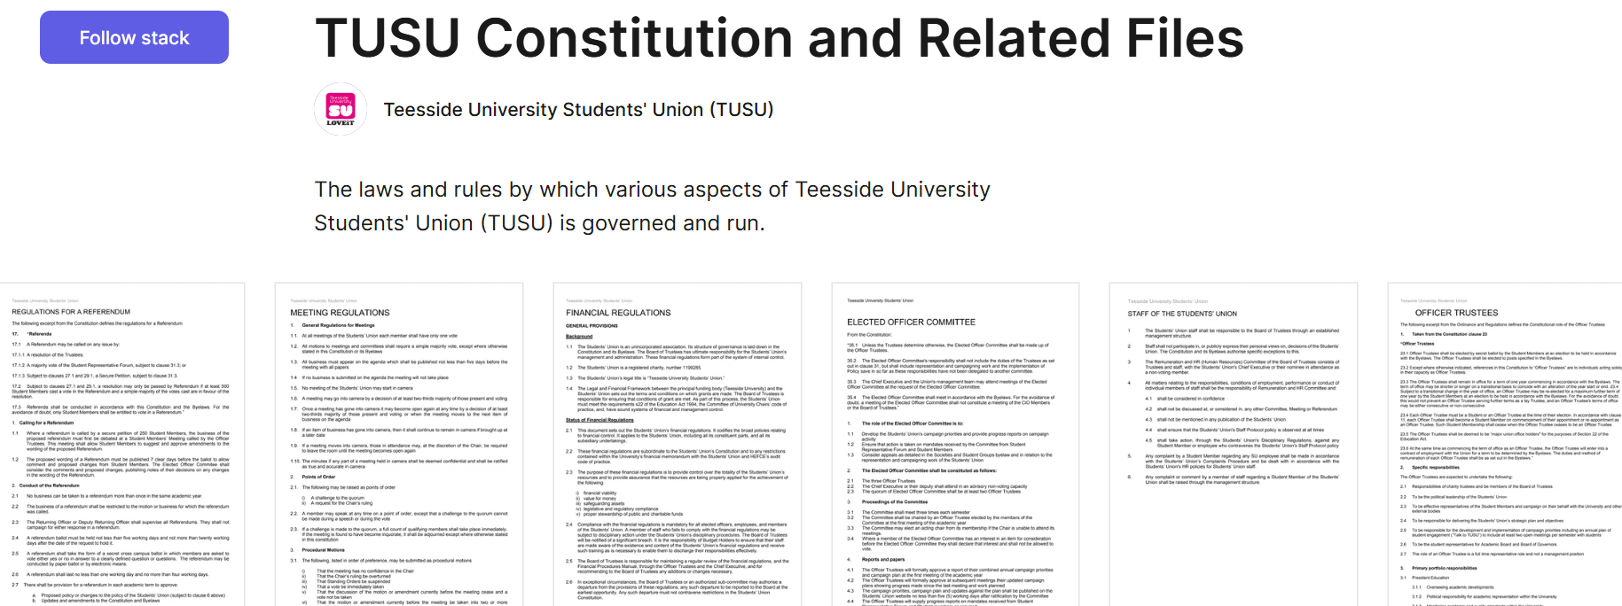

TUSU:
2. Comply with your charity’s governing documents and the law
Constitution
Catalogue of byelaws
Other laws – FoS, HR, Legal, Political activity, trading,

Slide 12
Trustee Responsibility – Main duties
3. Act in your charity’s best interests
You decide what will best enable the charity to carry out its purpose
Make balanced and adequately informed decisions (long & short term)
Avoid conflicts of interest
Not receive benefit from the charity

Slide 13
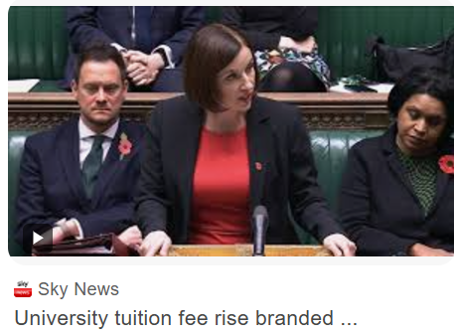

TUSU:
3. Act in your charity’s best interests
- Board of Trustees meetings
- Sub-committees
- Observe social media, changes in law, external factors in HE

Slide 14
Trustee Responsibility – Main duties
4. Manage your charity’s resources responsibly
Make sure assets are only used to support purpose
Not take inappropriate risks with charity’s assets or reputation
Not over-commit the charity
Care when investing and borrowing
Comply with restrictions on spending funds

Slide 15
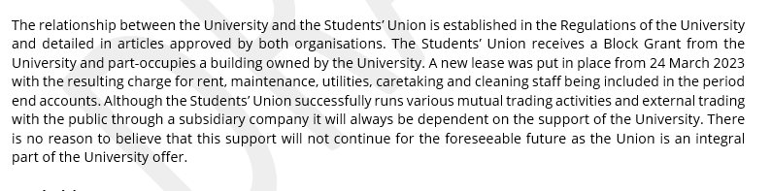
TUSU:
4. Manage your charity’s resources responsibly
Notes:
FARC
Auditors / Annual Report
Management Accounts – Board now and monthly internally
Restricted funds from the University
Some open donations available to bid for

Slide 16
Trustee Responsibility – Main duties
5. Act with reasonable care and skill
Make use of skills and experience
Give enough time, thought and energy to role (attending and actively participating in meetings)

Slide 17
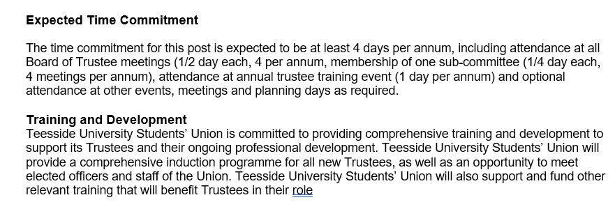
TUSU:
5. Act with reasonable care and skill

Slide 18
Trustee Responsibility – Main duties
6. Ensure your charity is accountable
Demonstrate charity is complying with law
Accountability to members
Accountability for charity (even in delegation)

Slide 19
TUSU:
6. Ensure your charity is accountable
Day to day activity delegated to CE
delegation framework
oversight of policies and procedures
oversight of governing documents
annual reporting
strategic accountability

Slide 20
7 decision making principles
Trustees must act within their powers
Trustees must act in good faith
Trustees must be sufficiently informed
Trustees must take account of all relevant factors
Trustees must identify and disregard irrelevant factors
Trustees must manage conflict of interest
Trustees must ensure their decision is within the range of decisions that a reasonable trustee body could make.

Slide 21
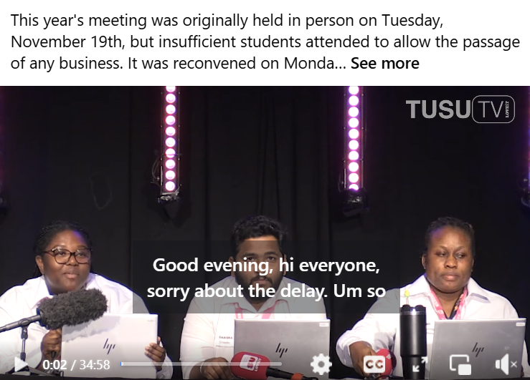
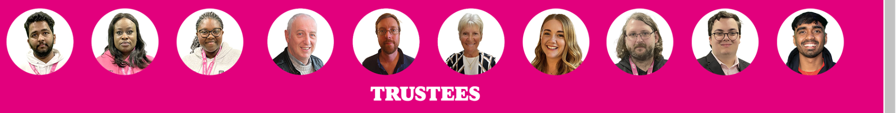

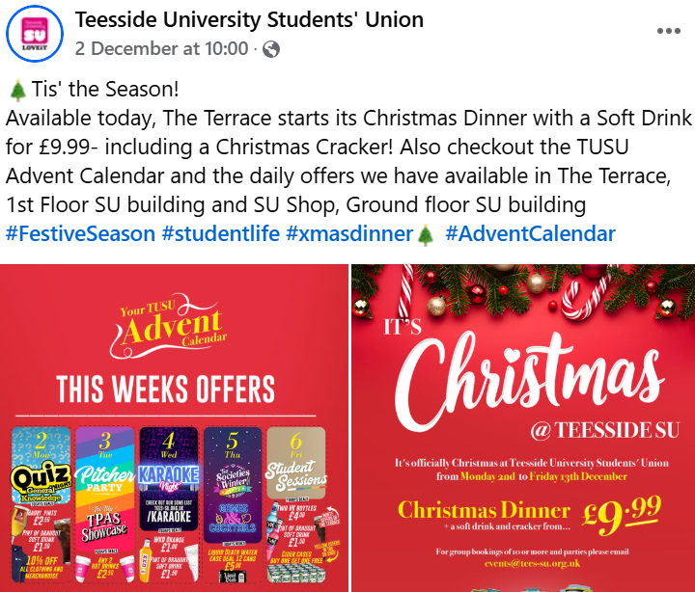

Notes:
Moving on to understanding SU’s
These might be some of the ways students see the SU
Top left, our AGM – Officers doing formal democracy and votes!
Bottom left – breakfast available
Middle – We talk to students
Bottom right – we have a cracking offer on for Christmas!

Slide 22

Why do we exist?

Slide 23
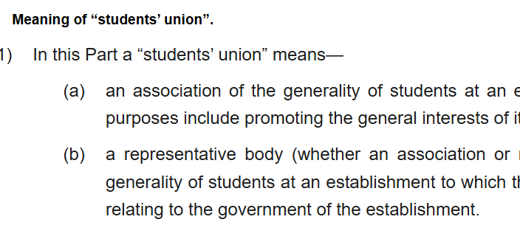
Why do we exist?
Enshrined in 1994 Education Act:
………promoting the general interests of its members as students.
Notes:
This means we HAVE to exist – but creates a tension with our funding partner – who can treat as ‘ANOTHER DEPARTMENT’. Play the rules / etc etc will go into more later.

Slide 24
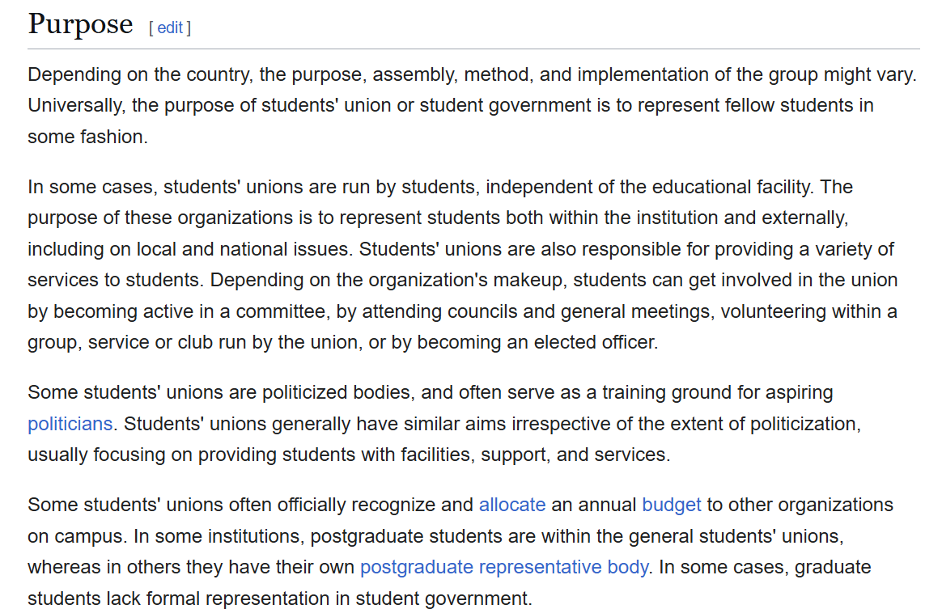
Why do we exist?

Slide 25
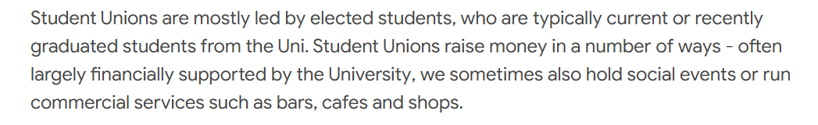
Why do we exist?

Slide 26
Why do we exist?
To give students a voice
To provide activities and broaden horizons
To help access advice needed
To develop new skills and enhance CV
To facilitate meeting new people
Notes:
The Students’ Union (SU) works in the same way as a workplace union. It campaigns for the rights of its members and lobbies on key issues, bringing them to the attention of your university, the National Union of Students and the government.
The SU organises day trips, activities and nights out during Freshers’ Week and throughout the rest of the year, as well as the Freshers’ Fair, where you can sign up for as many clubs and societies as you want. They can even help you set up your own society or club".
"Your SU can advise on your rights when it comes to things like student accommodation and private landlords and also offer you individual representation if you have a grievance with your university,“
Taking an active role in the SU is a good way to develop your negotiating and campaign skills. Many SU Sabbatical Officers have gone on to careers in politics or become key influencers in social policy and business. If you run and are elected as an SU Officer you will receive national training in all of the key skills you need, as well as opportunities for development throughout the year. SU Officers represent students at local and national events, so you can practice your networking skills while doing something for a cause you are passionate about!".
"You can choose how much you want to get involved with your union,” says Ayo. “You can use it as a one stop shop to find out about societies and clubs, take part in campaigns, or even run as an officer to help represent a cause that is important to you. It’s completely up to you".

Slide 27
Why we exist?
The University notices we do two things:
Notices | Demonstrates | Impact
Societies | Impact on recruitment, retention, completion and employability | Impact report and imagery
Student representatives | The positive impact on university decision making and external scrutiny | Sharing/shaping concerns Support SMT change agenda

Slide 28
TUSU
We need to be so good that they can’t ignore us
We need to use data to our advantage
We need to become an internal influencer
We need to build culture
We need to be their go to expert

Slide 29
TUSU
SU activities,
Licensed Trade,
SU Shop,
Finance, HR & Marketing,
Facilities & Events
SU Student Support
all overseen by BoT, Officer and SMT
Notes:
New cases: 39 (22% down on last year)
11 Academic Appeals (5 informal)
1 Academic Misconduct (informal)
12 Attendance Appeal
5 Accommodation
4 Complaints (3 formal)
1 Disciplinary
1 FtP
3 Misc
Cases worked on this month: 111
Closed this month: 52
Hearings/meetings: 9 (This is an addition to routine appointments)
Drop ins: 33 (8 welfare)

Slide 30
Role, Rules and Regs
Dows
Notes:
10.30am

Slide 31
Two Roles Available
President (Home Students)
President (International Students)
5 Part-Time Officers
Notes:
10.30am

Slide 32
ALL Students will vote in President roles
Notes:
10.30am

Slide 33
The Role is Full-Time
Notes:
10.30am

Slide 34
You will be given training and support to represent and campaign for students here at Teesside
Notes:
10.30am

Slide 35
The Returning Officer
is Peter Robertson (NUS)
Notes:
10.30am

Slide 36
The Deputy Returning Officers:
Kirsty and Dows
Notes:
10.30am

Slide 37
Decisions are final
Notes:
10.30am

Slide 38
Elections Values:
Community
Friendship
Excitement
Respect
Notes:
10.30am

Slide 39
The Rules
Notes:
10.30am

Slide 40
1) The law, University Policies and Union Regulations are all in full force and shall apply to TUSU elections
Notes:
10.30am

Slide 41
2) Students must be free to cast their vote without undue pressure or influence
Notes:
10.30am

Slide 42
3) Candidates must treat other candidates, students, staff and members of the public with respect
Notes:
10.30am

Slide 43
4) Candidates must not undermine the fair and democratic running of elections
Notes:
10.30am

Slide 44
5) Candidates must not do anything to gain an unfair advantage
Notes:
10.30am

Slide 45
6) Candidates must respect the campus environment and the community
Notes:
10.30am

Slide 46
8) Campaigning does not start until 9am, Monday 25th February, all candidates are required to complete / submit the pre-requisite training / information as outlined within this guide.
Notes:
10.30am

Slide 47
9) Candidates must not interfere in any way with a voter at the point of voting.
Notes:
10.30am

Slide 48
10) Candidates must not promote their campaigns via the use of TUSU resources, including official TUSU accounts, staff or Executive Officer time, unless a service is offered to all candidates via TUSU central provision.
Notes:
10.30am

Slide 49
11) Candidates are reminded that TUSU staff are not eligible to campaign on your behalf whereas student staff may campaign for candidates but must not use their position to do so and must do so in their own time.
Notes:
10.30am

Slide 50
12) Candidates who have access to students’ personal data (contact details), as part of a Society or representative role for example, cannot use this as part of their campaign; it is important to remember that students within those groups have not consented to receiving messages that encourage students to vote for a candidate(s) and this may be perceived as a breach of General Data Protection Regulations.
Notes:
10.30am

Slide 51
13) Candidates can create mailing lists for the sole purpose of promoting their candidacy; these must clearly inform students on the purpose of collating this data and they should be able to withdraw their consent at any point.
Notes:
10.30am

Slide 52
14) Candidates are able to seek endorsements from Societies and Academic Representatives however this cannot happen until campaigning has started
Notes:
10.30am

Slide 53
15) In order to retain fairness in the elections, candidates will receive a budget of £25. This is provided by the Union and will be reimbursed after the results; this cannot be supplemented and is subject to the presentation of all receipts, alcohol will not be reimbursed.
Notes:
10.30am

Slide 54
16) You can submit your expenses at any time however these must be received by 1pm on Thursday 5th March.
Notes:
10.30am

Slide 55
17) Recording of students voting is prohibited.
Notes:
10.30am

Slide 56
Voting is open from 10am Tuesday 3rd - 5th March 4pm only.
Notes:
10.30am

Slide 57
If a candidate wishes to make a formal complaint about another candidate, they must write to elections@tees-su.org.uk where they will be directed to a link to complete a complaint form. This must be fully completed with any evidence uploaded.
Notes:
10.30am

Slide 58
Questions?
Notes:
10.30am

Slide 59
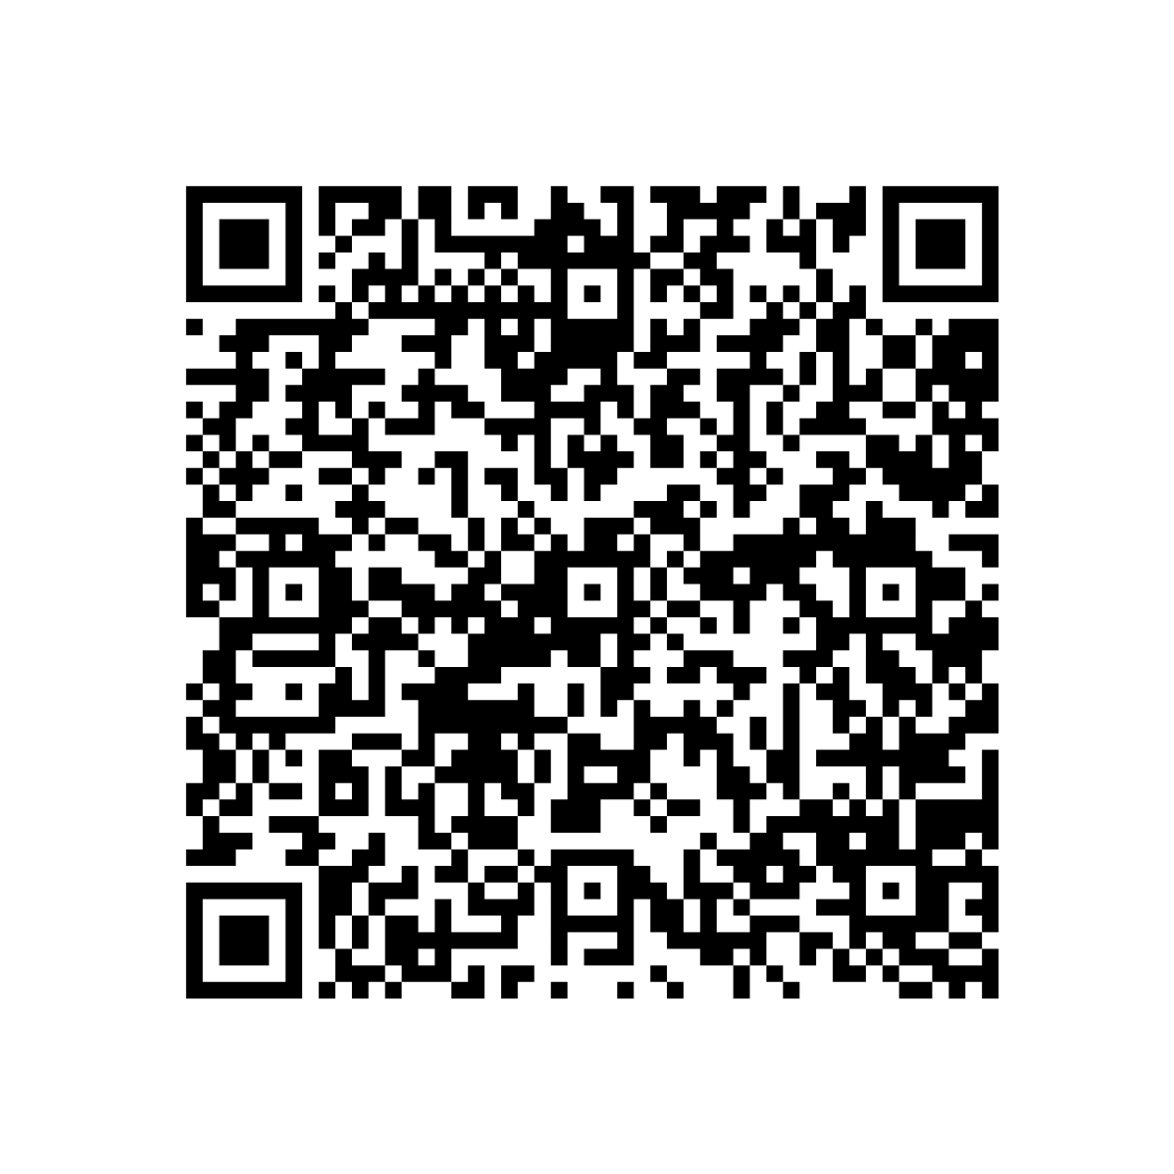
Sign the Rules
Notes:
10.30am

Slide 60
Break
Notes:
10.30am

Slide 61
Candidate Support
Voting days are great fun, but are also busy and tiring. Take time to have a break and look after yourself.
Candidate’s Lounge: 10-4pm voting days, refreshments available
Pastoral support: Communities Team
Email or pop in
Notes:
10.30am

Slide 62
How to Campaign
Notes:
10.30am

Slide 63
What do we mean when we say Election Campaign?
Notes:
10.30am

Slide 64
A campaign is a period of activity designed to encourage people to:
Vote
Vote for you
Notes:
10.30am

Slide 65
You are probably going to lose…
Notes:
10.30am

Slide 66
Step 1: What is a win?
Notes:
10.30am

Slide 67
Step 2: What is the problem and how do you fix it?
Notes:
10.30am

Slide 68
Step 3: Forming a team
Notes:
10.30am

Slide 69
Step 4: Planning the campaign
Notes:
10.30am

Slide 70
Understanding Voting
Notes:
10.30am

Slide 71
Kitten A | 3
Kitten B | 1
Kitten C | 2
Dog
RON | 4
Notes:
10.30am

Slide 72
Kitten A | 12
Kitten B | 8
Kitten C | 7
Dog | 4
RON | 1
Notes:
10.30am

Slide 73
Kitten A | 12
Kitten B | 8
Kitten C | 7
Dog | 4
RON | 1
Notes:
10.30am

Slide 74
Kitten A | 12 | 12
Kitten B | 8 | 11
Kitten C | 7 | 8
Dog | 4
RON | 1
Notes:
10.30am

Slide 75
Kitten A | 12 | 12 | 15
Kitten B | 8 | 11 | 16 | Winner
Kitten C | 7 | 8
Dog | 4
RON | 1
Notes:
10.30am

Slide 76
Canvassing Voters
How to gain Trust and Manipulate people
Notes:
10.30am

Slide 77
Level 0 - Master/Slave
Level 1 - Professional
Level 2 - Trusted
Level 3 - Loving
Notes:
10.30am

Slide 78
Share’s my Values
Notes:
10.30am

Slide 79
Step 5: Stay Focussed
Notes:
10.30am

Slide 80
Step 6: Creating content
Notes:
10.30am

Slide 81
Candidate resources
Notes:
10.30am

Slide 82
The 5-Second Rule
Notes:
10.30am

Slide 83

Notes:
10.30am

Slide 84

Notes:
10.30am

Slide 85
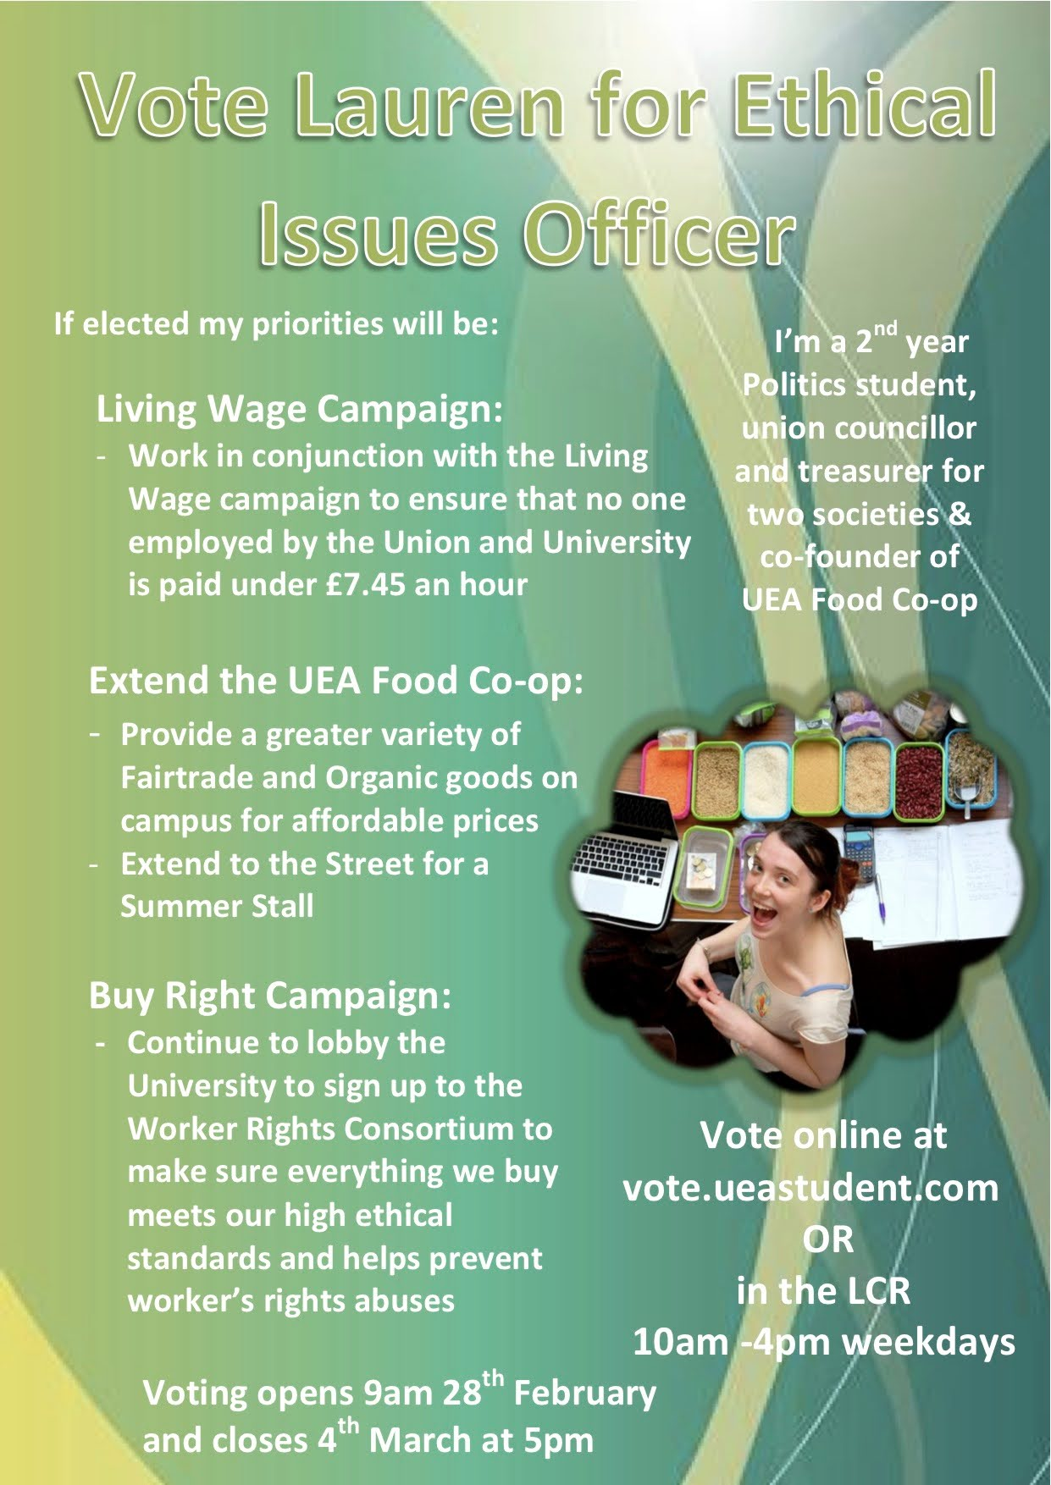
Notes:
10.30am

Slide 86
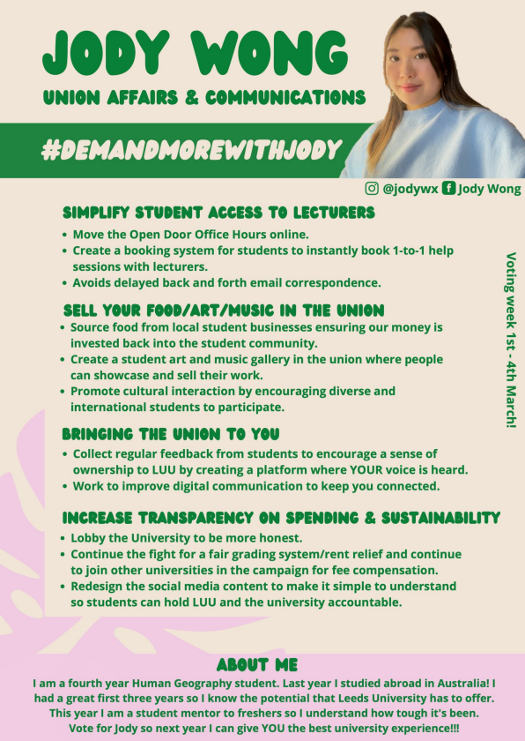
Notes:
10.30am

Slide 87
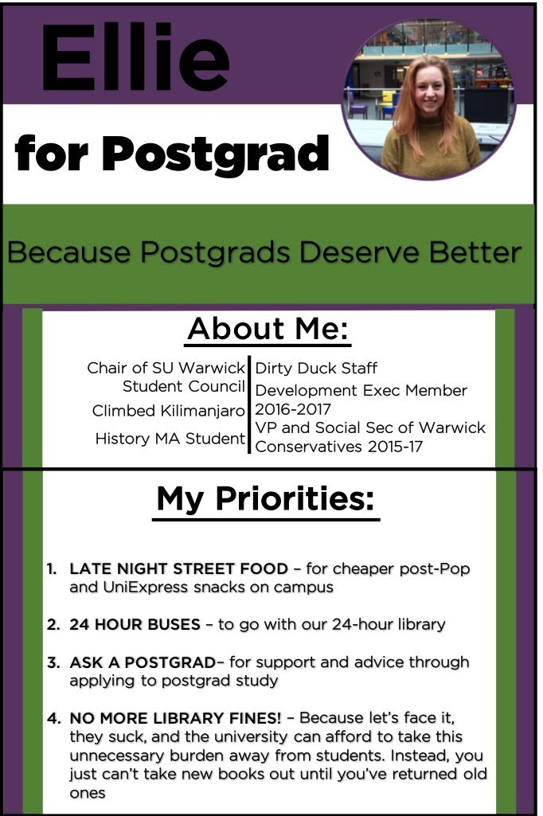
Notes:
10.30am

Slide 88
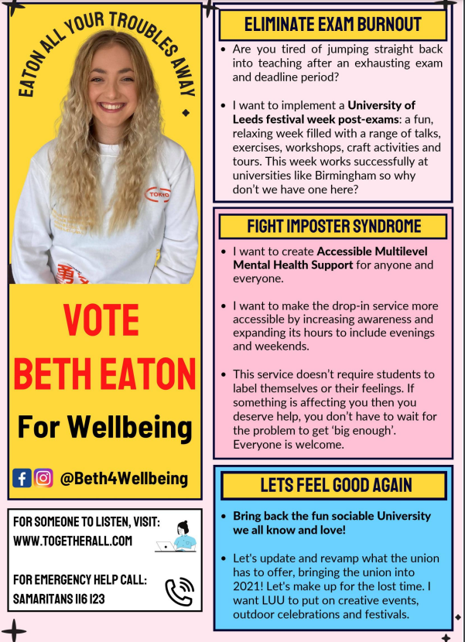
Notes:
10.30am

Slide 89

Notes:
10.30am

Slide 90
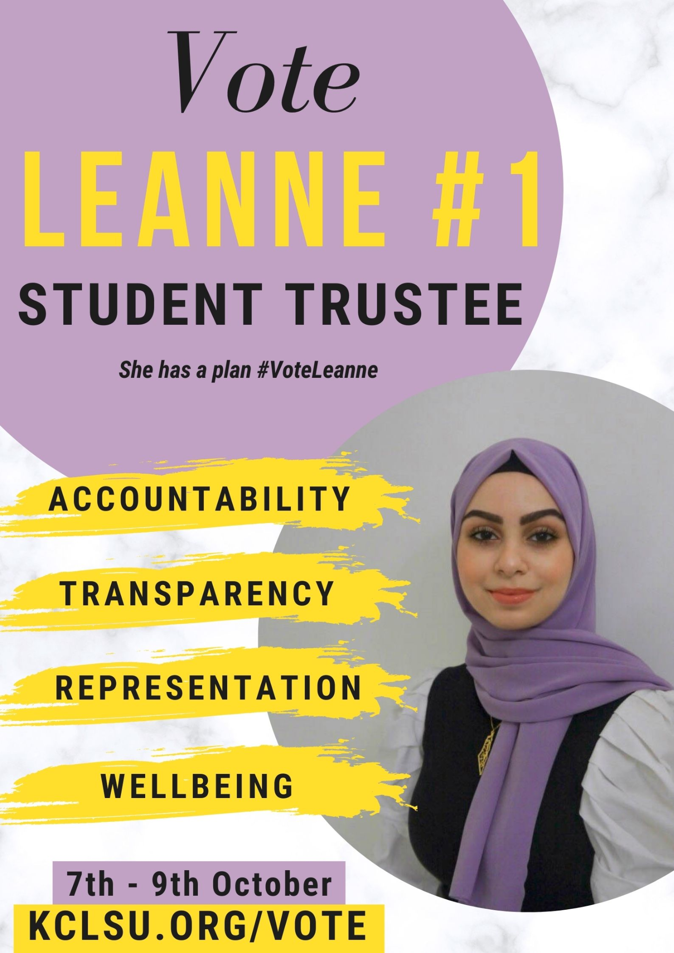
Notes:
10.30am

Slide 91

Notes:
10.30am

Slide 92
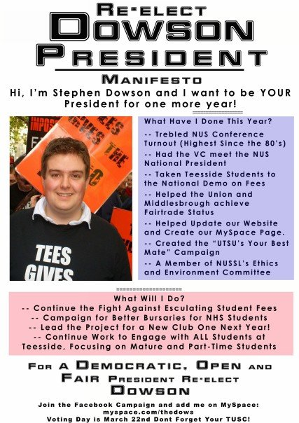
Notes:
10.30am

Slide 93
Questions?
Notes:
10.30am

Slide 94
Thanks and Photos
Notes:
10.30am

